Slide 1









FINSECURE BANK
ISO/IEC 27001
JUNE 2026
INTERNAL AUDIT REPORT
Visit Our Website
www.finsecurebank.com
KEERTENNAH DEVI A/P PONNAMBALAM (MEC254026)

Slide 2




FinSecure Bank
GROUP AUDIT TEAMS
KEERTENNAH DEVI
LILIAN
NETHRA
Lead Auditor
Overall audit management, scoping, BNM RMiT compliance oversight and final reporting
Technical Auditor
Evaluation of Cloud infrastructure security, mobile/web app vulnerabilities and technical access controls
Compliance Auditor
Review of supplier contracts, risk assessment frameworks, policy documentation and operational records

Slide 3

FinSecure Bank
Audit Scope & Prepration
About FinSecure Bank: A mid-sized digital banking institution operating exclusively within the highly regulated financial ecosystem of Malaysia.
Core Digital Ecosystem In-Scope:
Online Banking (Web Platform)
Mobile Banking Application
Cloud-Based Customer Data Storage (AWS Infrastructure)
Third-Party Payment Gateway Integrations (FPX / PayNet APIs)
Audit Objectives
• To evaluate FinSecure Bank’s readiness for formal ISO/IEC 27001 certification.
• To assess compliance with mandatory ISO 27001 clauses (Clauses 4–10) and specific Annex A security controls
•To identify security gaps, operational vulnerabilities, and areas of non-conformity before the external certification audit.

Slide 4

FinSecure Bank
Selected Checklist Section
The audit targeted four critical risk domains:
Risk Assessment (Clause 6.1.2 & 6.1.3): Evaluating how information security risks are identified, analyzed, and treated.
Access Control (Annex A.8.15 - A.8.18): Reviewing user provisioning, multi-factor authentication, and privileged access management.
Cloud Security (Annex A.5.23, A.8.10, A.8.22): Reviewing data segregation, cloud configuration management, and storage security.
Supplier Management (Annex A.5.19 - A.5.22): Inspecting security requirements in third-party payment gateway SLAs and vendor contracts.

Slide 5
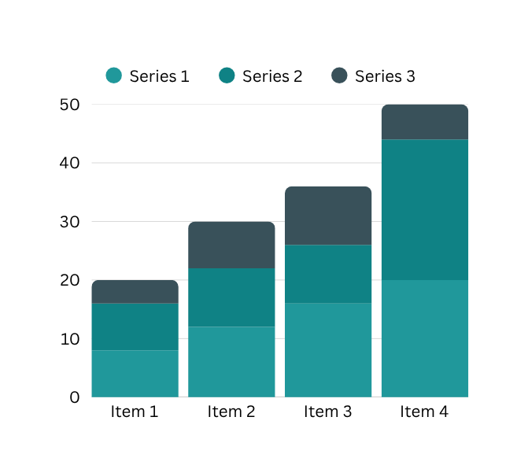
FinSecure Bank
Audit Execution & Recommendations
The audit team executed testing through document reviews, technical configuration audits, and personnel interviews. The 5 core findings categorized by severity, mapped to ISO 27001 controls, and paired with immediate corrective actions.

Slide 6
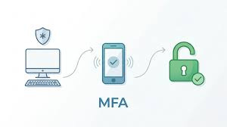
Finding 1: MFA Failure
FinSecure Bank
Classification: Major Non-Conformity
Issue: During a technical configuration review of the cloud environment hosting sensitive customer data, it was discovered that two root administrative accounts and three senior developer accounts did not have Multi-Factor Authentication (MFA) enforced. Access relied solely on single-factor passwords.
ISO Mapping: Annex A.8.5 (Secure Authentication)
Risk Impact: Critical risk of credential stuffing or brute-force attacks. If an administrative account is compromised, unauthorized entities could gain full access to the cloud backend, leading to massive customer data exfiltration, regulatory penalties from Bank Negara Malaysia and severe brand damage..
Corrective Actions: Mandate and enforce hardware or app-based MFA for all administrative and privileged cloud accounts immediately.
Preventive Control: Implement an automated Identity and Access Management (IAM) policy that blocks authentication attempts from accounts without active MFA.
Priority Level: High

Slide 7

FinSecure Bank
Finding 2: Incomplete Third-Party Supplier Risk Assessments
Classification: Major Non-Conformity
Issue: The bank integrates with a new niche third-party payment gateway for cross-border transactions. However, there was no evidence of an information security risk assessment or a Right-to-Audit clause executed prior to signing the vendor contract..
ISO Mapping: Annex A.5.19 (Supplier Relationships ) Clause 6.1.2 (Information security risk assessment).
Risk Impact: The bank cannot guarantee that the payment gateway complies with baseline security practices. A breach at the vendor level could compromise FinSecure Bank’s transactional data pipelines, resulting in financial fraud and supply-chain vulnerabilities.
Corrective Actions: Halt non-essential data transfers and issue a retroactive security questionnaire to the vendor, requiring proof of their ISO 27001 certification.
Preventive Control: Update the Procurement Policy to legally prohibit the onboarding of any third-party IT vendor without a completed Security Risk Assessment signed off by the CISO.
Priority Level: High

Slide 8

Finding 3: IAM Offboarding
FinSecure Bank
Classification: Minor Non-Conformity
Issue: HR offboarding logs against active Active Directory accounts revealed that employees who resigned from the bank 30 to 45 days ago still possessed active network and web banking backend access credentials.
ISO Mapping: Annex A.7.6 (Termination Responsibilities)
Risk Impact: Medium risk of insider threat or unauthorized systems access. Former employees could potentially log in remotely to alter configurations or download internal data assets.
Corrective Actions: Deprovision and disable all identified stale user accounts immediately.
Preventive Control: Create a synchronized, automated workflow between the HR Management System and Active Directory so that marking an employee as "Terminated" automatically suspends all IT access keys of their final day.
Priority Level: Medium.

Slide 9

Finding 4: Data Classification
FinSecure Bank
Classification: Minor Non-Conformity
Issue: AWS S3 buckets containing transaction logs lacked mandatory classification metadata tags.
ISO Mapping: Annex A.5.12 (Classification of Information)
Risk Impact: Without explicit classification tags, automated data loss prevention (DLP) tools cannot accurately detect and prevent sensitive data leaks, increasing the probability of accidental public exposure.
Corrective Actions: Manually review and apply correct metadata classification tags to the identified cloud buckets.
Preventive Control: Deploy infrastructure-as-code (IaC) guardrails that automatically reject the creation of any new cloud storage asset if data classification tags are missing from the deployment script.
Priority Level: Medium.

Slide 10

Finding 5: Outdated Asset Register Review Cycle
Classification: Observation (OFI)
Issue: The Information Asset Register for FinSecure Bank’s mobile application infrastructure was complete and accurate, but it had not been formally reviewed or updated in the last 11 months. The internal policy requires a semi-annual (6-month) review.
ISO Mapping: Annex A.5.9 (Inventory of Assets)
Risk Impact: Low operational risk. If asset reviews lag, newly spun-up software microservices or hardware assets might go undocumented, leading to blind spots in future security patching cycles.
Corrective Actions: Conduct a formal review and sign-off of the current Information Asset Register by the asset owners.
Preventive Control: Setup automated calendar reminders and email alerts triggered by the compliance platform 30 days before the 6-month review deadline expires...
Priority Level: Low.
FinSecure Bank

Slide 11
FinSecure Bank
KEY FINDINGS SUMMARY
ID | Key Finding | ISO Mapping | Class | Risk Level
F1 | MFA Failure | Annex A.8.5 | Major Non-Conformity | High
F2 | Incomplete Third-Party Supplier Risk Assessments | Annex A.5.19 & Clause 6.1.2 | Major Non-Conformity | High
F3 | Delayed IAM Offboarding | Annex A.7.6 | Minor Non-Conformity | Med
F4 | Data Classification | Annex A.5.12 | Minor Non-Conformity | Med
F5 | Outdated Asset Register Review Cycle | Annex A.5.9 | Observation | Low

Slide 12
FinSecure Bank
Recommendation Roadmap
To successfully pass the upcoming external ISO/IEC 27001 certification audit, FinSecure Bank's leadership must prioritize resources toward resolving the items detailed mentioned.
PHASE 1: 0-14 DAYS
PHASE 2: 30 DAYS
PHASE 3: 60 DAYS
Immediate Remediation
The CISO must enforce the deployment of MFA across all administrative accounts (F1) and request compliance documentation from the third-party gateway provider (F2) within the next 7 business days. External auditors will automatically fail an organization if Major Non-Conformities remain unresolved..
Process Automation
Move away from manual checklists by integrating automated controls. Syncing HR databases to Active Directory systems (F3) and utilizing Infrastructure-as-Code policy blocks (F4) ensures compliance remains continuous rather than point-in-time..
Certification Audit
Once corrective actions are implemented, the Compliance Auditor should perform a targeted follow-up spot check 15 days post-remediation to verify that the controls are functioning effectively and to officially close out these findings.

Slide 13
Discussion
FinSecure Bank
Strategic Audit Insights & Operational Reflections
The Weight of Local Regulatory Scrutiny
Transition from Static to Automated Governance
Operating in Malaysia means satisfying international ISO 27001 standards is only half the battle. For financial institutions, alignment with BNM RMiT directives means third-party vendor blind spots like missing contractually protected Right-to-Audit clauses on transaction APIs pose immediate operational and legal existential threats.
This internal audit highlighted that traditional, point-in-time checklist reviews are completely inadequate for a fast-evolving digital banking ecosystem. Gaps like delayed IAM offboarding (30–45 days) underscore that compliance must be engineered directly into operations via automation rather than manual human processes.
Value of Pre-Certification Assessments
Cloud Infrastructure vs.
Compliance Visibility
Discovering two major non-conformities early prevents a definitive failure during the formal external certification audit. It allows the audit team to establish an assertive engineering roadmap to transition FinSecure Bank into a continuously secure state
Our review of the AWS environment proved that strong technical infrastructure is easily undermined by loose configuration controls. Leaving root accounts without active Multi-Factor Authentication (MFA) and ignoring mandatory data classification metadata tags on S3 storage buckets exposes the bank to catastrophic exposure vectors.

Slide 14


FinSecure Bank
Conclusion
Audit Metric Breakdown: 2 Major Non-Conformities
2 Minor Non-Conformities
1 Observation
Core Risk Vulnerability Focus: FinSecure Bank's most volatile operational exposure vectors reside within its privileged access governance boundaries and third-party payment gateway integration points.
Final Certification Readiness Status: FinSecure Bank is not currently positioned to successfully pass the formal external ISO/IEC 27001 certification audit. External accreditation bodies will trigger an automatic audit failure due to the unresolved Major Non-Conformities.
Authorization to Proceed: The compliance and technical teams are authorized to immediately initiate the 0–60 day remediation roadmap. Proceeding to the external certification audit phase is strictly conditional upon the technical deployment of app-based MFA enforcement and retroactive supplier security vetting.

Slide 15


FinSecure Bank
THANK
Report Compiled By Keertennah Devi, Lead Auditor Lilian, Technical Auditor Nethra Compliance Auditor
YOU
Confidential Internal Audit Report | FinSecure Bank
Visit Our Website
www.finsecurebank.com

